Slide 1
QUERY PROCESSING
1. AN OVERVIEW OF QUERY PROCESSING
2. FAST ACCESS PATHS
3. TRANFORMATION RULES
4. ALGEBRA-BASED OPTIMIZATION

Slide 2
An overview of query processing
When a user query is received, query processor first checks
- whether the query has the correct syntax and
- whether the relations and attributes it references are in the database.
Next, if the query is acceptable, then an execution plan for the query is generated.
Def: An execution plan is a sequence of steps for query execution. Each step in the plan corresponds to one relational operation plus the method to be used for the evaluation of the operation.

Slide 3
Example of Execution plan
For a given relational operation, there are a number of methods that can be used to evaluate it.
Example:
SELECT * FROM R, S, T
WHERE R.A > a AND R.B = S.B AND S.C = T.C
A possible execution plan for this query consists of :
1. Perform selection σ _{A>a} (R) based on a sequential scan of the tuples of R. Let R1 be the result of this selection.
2. Perform join R1  _{R1.B = S.B} S using a sort merge join algorithm. Let R2 be the result of the join.
3. Perform join R2  _{R2.C = T.C} T using the nested loop join algorithm

Slide 4
Execution plan (cont.)
An alternative execution plan:
1. σ _{A>a} (R). Let R1 be the result.
2. S  _{S.C = T.C} T. Let R3 be the result.
3. R1  _{R1.B = R3.B} R3
Different execution plans that can produce the same result are said to be equivalent.
However, different equivalent plans are evaluated with very different costs.

Slide 5
Cost of evaluating a query
The goal of query optimization is to find an execution plan, among all possible equivalent plans, that can be evaluated with the minimum cost. Such a plan is an optimal plan.
In a centralized database system, the cost of evaluating a query is the sum of two components, the I/O cost and the CPU cost.
•The I/O cost is caused by the transfer of data between main memory and secondary memory.
•The CPU cost is incurred when tuples in memory are joined or checked against conditions.

Slide 6
Cost of evaluating a query (cont.)
For most database operations, the I/O cost is the dominant cost. To reduce I/O cost, special data structures, such as B+ trees, are used.
For a single processor environment, minimizing the total cost implies the minimization of the response time.

Slide 7
Search space of query optimization
The number of equivalent execution plans for a given query is determined by two factors:
- the number of operations in the query and
- the number of methods that can be used to evaluate each operation.
Example: If there are m operations in a query and each operation can be evaluated in k different ways, then there can be as many as (m!).k^{m} different execution plans.
The set of all equivalent execution plans is the search space for query optimization.

Slide 8
Guidelines for query optimization
Due to the very large number of possible execution plans, finding an optimal execution plan is very difficult.
Some guidelines for query optimization:
1. For some special types of queries for which an optimal execution can be found in a reasonable amount of time, it is worthwhile to find the optimal plan.
2. For general queries,
- heuristics to obtain a reasonable but not optimal plan.
- A reduced search space is used so that an optimal plan based on the reduced space can be found.

Slide 9
Neither of them guarantees the finding of a real optimal execution plan.
Two methods of optimization
Algebra-based optimization: uses a set of heuristic transformation rules.
Cost estimation-based optimization: for each query, estimate the cost of every possible execution plan and choose the execution plan with the lowest estimated cost.

Slide 10
Fast Access Paths
Special data structures are frequently used in database systems for speeding up searches and for reducing I/O costs.
These data structures play a very important role in query optimization.

Slide 11
Storage hierarchy
A typical storage hierarchy for database applications consists of two levels:
The first level: main memory
The second level: secondary memory (disk pack)
• Characteristic of main memory:
fast access to data, small storage capacity
volatile, expensive
• Characteristic of secondary memory:
slow access to data, large storage capacity
nonvolatile, cheap

Slide 12
Pages of disk storage
A typical disk pack consists of a number of disks sharing the same spindle. Each disk has two surfaces.
Each surface has a few hundred information storing circles and each such circle is called a track.
The set of tracks in the same diameter on all disk surfaces is called a cylinder.
Each track is partitioned into many pages (sectors or blocks). The size of a page is 2 KB or 4 KB.
The page is the smallest unit for transferring data between main memory and secondary storage.

Slide 13
Indexes
Index: A data structure that allows the DBMS to locate particular records in a file more quickly, and thereby speed response to user queries.
An index structure is associated with a particular search key, and contains records consisting of the key value and the address of the logical record in the file containing the key value.
The file containing the logical records is called the data file. The file containing the index records is called the index file.
The values in the index file are ordered according to the indexing field.

Slide 14
Primary index and secondary index
A file may have several indices, on different search key.
Primary Index and Secondary Index
If the data file is sequentially ordered, and the indexing field specifies the sequential ordering of the file, the index is called a primary index.
(The term primary index is sometimes used to mean an index on a primary key. Such usage is non-standard.)
The index whose search key specifies an order different from the sequential order of the file is called secondary index.

Slide 15
Dense Index and Sparce Index
An index can be sparse or dense. A dense index has an index record for every search key value in the file. A sparse index has an index record for some of the search key values in the file.
Example:
The dense index and sparse index for ACCOUNT table.
ACCOUNT(Branch-name, Account-no, Balance)
The indexing field is Branch-name.

Slide 16
Brighton
Downtown
Mianus
Perryridge
Redwood
Round Hill
Brighton A-217 750
Downtown A-101 500
Downtown A-110 600
Mianus A-205 700
Perryridge A-102 400
Perryridge A-201 900
Perryridge A-218 700
Redwood A-222 700
Round Hill A-305 350
Brighton
Mianus
Redwood
Brighton A-217 750
Downtown A-101 500
Downtown A-110 600
Mianus A-205 700
Perryridge A-102 400
Perryridge A-201 900
Perryridge A-218 700
Redwood A-222 700
Round Hill A-305 350

Slide 17
Secondary Index
In general, secondary indices may be structured differently from primary indices.
If the search key of a secondary index is not a candidate key, it is not enough to point to just the first record with each search key value. The remaining records with the same search key value could be any where in the file.
The pointers in a secondary index do not point directly to the file. Instead, each points to a bucket that contains pointers to the file.

Slide 18
Example of secondary index
350
400
500
600
700
750
900
Brighton A-217 750
Downtown A-101 500
Downtown A-110 600
Mianus A-205 700
Perryridge A-102 400
Perryridge A-201 900
Perryridge A-218 700
Redwood A-222 700
Round Hill A-305 350

Slide 19
B+ Tree
B+ tree is an index structure widely used in database systems.
A node in the tree is either an internal node or a leaf node. An internal node has one or more children whereas a leaf node has no children.
The leaf nodes have the format (a₁, P₁; a₂, P₂;…; a_{m}, P_{m}; P), where a_{i}’s are A-values satisfying
a₁ < a₂ < …< a_{m} and P is a leaf node pointer, pointing to the next leaf node. These leaf nodes form a linked list.

Slide 20
B+ Tree (cont.)
P₁ a₁ … a_{i-1} P_{i} a_{i} … a_{k-1} P_{k}
a <= a₁
…
a_{i-1}< a<= a_{i}
…
a_{k-1} < a
Leaf nodes are ordered in ascending values; that is, if node i precedes node j in the linked list, then all A-values in node i are less than (or equal to) in node j.
The leaf-node-pointers in leaf nodes provide a way to access the tuples in an ordered manner.

Slide 21
The pointer in the leaf node
The pointer P_{i} in the leaf nodes:
1. If the tuples of R are stored in ascending A-values, the B+ tree index is called clustered index (or a primary index). In this case, each P_{i} is either
- a tuple pointer pointing to the tuple whose A-value is a or
- a page pointer pointing to a page of R that contains the tuple whose A-value is a_{i}.

Slide 22
The pointer in the leaf node (cont.)
2. If the tuples of R are not stored in ascending A-values, then the B+ tree index is called nonclustered index (or secondary index).
- A is a key. In this case, each P_{i} is a tuple pointer, pointing to the tuple whose A-value is a_{i}.
- A is not a key. P_{i} is a pointer to a page N that contains tuple pointers to tuple(s) whose A-value is a_{i}.

Slide 23
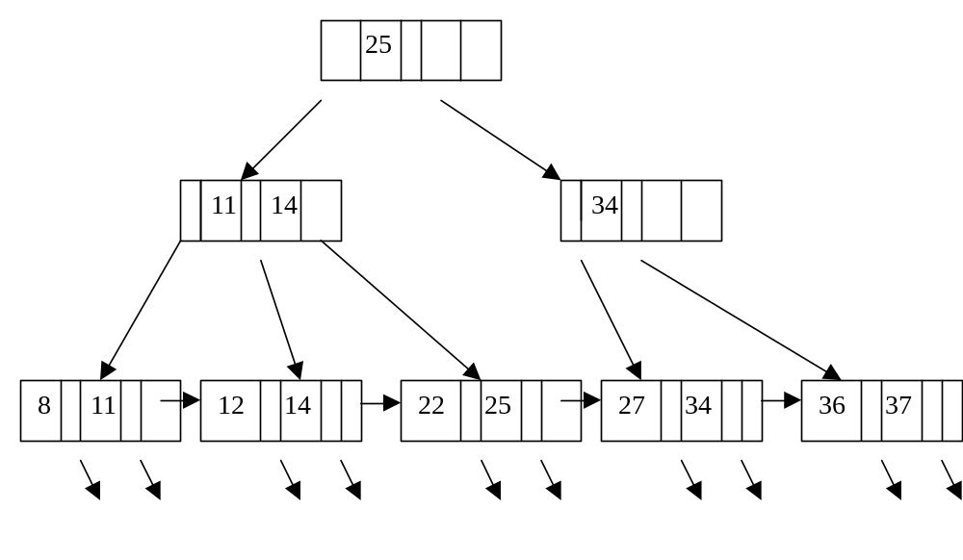
Figure of B+ tree

Slide 24
Searching on B+ tree
The algorithm for searching a tuple (or tuples) with A-values equal to a is described below.
Search(a, T) // T points to the root node of B+ tree
1. If T is an internal node, then compare a with the A-values in T to determine the tree pointer to follow and the next node to search. If a ≤ a₁, then call Search(a, P₁); if a_{i-1} < a ≤ a_{i} then call Search(a, P_{i}); if a > a_{k-1}, then call Search(a, P_{k}). A binary search is used to speed up the search to the right P_{i}.
2. If T is the leaf node, compare a with the A-values in T. If no A-values in T is equal to a, report not found. If a_{i} in T is equal to a, follow pointer P_{i} to fetch the tuple(s).

Slide 25
Efficiency of search on B+ tree
The performance of search algorithm is closely related with the height of B+ tree. If n is the number of distinct A-values in R, then the height of the B+ tree is ≈ log_{F} n, where F is the average fan-out of the tree.
F is usually large, a B+ tree of 3 to 4 levels can accommodate a very large relation.
Example: Page = 2K bytes, each <a,P> has 15 bytes. Each page store 100 such pairs. Then 10,000 leaf nodes are needed. 10,000 leaf nodes can contain 1,000,000 tuples.
1 –> 100 –> 10,000

Slide 26
Some disadvantages of B+ tree
The height of a B+ tree is often a small number.
Although searching in a B+ tree is quite fast, inserting into and deleting from a B+ tree are complicated.
• Inserting a new value in a leaf node may cause the node to overflow. The overflow causes the node to be split into two nodes. The splitting effect may propagate all the way to the root node.
• Deleting a value from a leaf node may cause it to underflow. And the underflow cause the merge of this node with one of its sibling nodes. The merging may propagate all the way to the root node.

Slide 27
Hashing
Hashing is another widely used method for providing fast access to desired tuples in a relation.
The idea: To build a hash table that contains an index entry for each tuple in the relation and to use a hash function h() to identify each entry in the hash table.
The hash table consists of many buckets. The number of buckets is determined in advance, based on the number of tuples in the relation.
Each bucket ≈ one or more disk pages.

Slide 28
Hash function
Let A be the attribute used to provide fast access.
The contents of each bucket is a number of index entries of the form <a, P>, where a is the A-value of some tuple and P is a tuple pointer, pointing to the tuple on disk.
A hash function h() is used to map each A-value in the relation to a number, called the bucket number. Buckets are numbered from 0 to n-1, where n is the number of buckets used.
The hash function maps any valid A-value to an integer between 0 and n-1.

Slide 29
Hashing (cont.)
Let t be a tuple and a be the A-value of t. If
h(a) = k, 0≤ k ≤ n-1, entry <a, P> is placed in the kth bucket of the hash table. After an entry is created and placed in an appropriate bucket for every tuple of the relation, the build of the hash table is complete.
♦ It is possible that too many A-values are mapped to the same bucket and it cannot hold all the entries. This is bucket overflow.
A solution to bucket overflow problem is to place overflow entries into overflow buckets and link these overflow buckets to regular buckets.

Slide 30
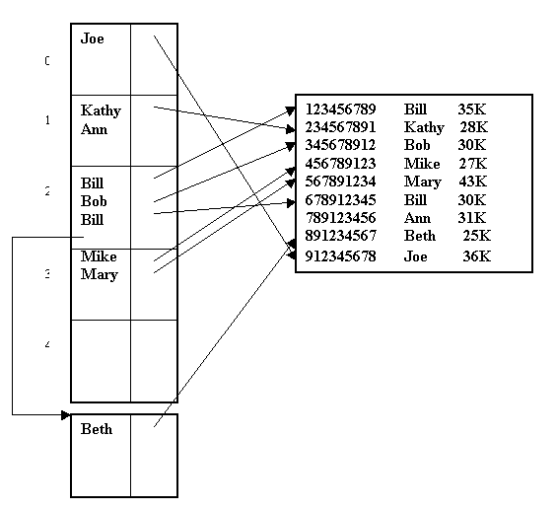

Slide 31
Drawbacks of Hasing
Hashing is the fastest method for finding tuples with a given A-value. However, hashing has several drawbacks.
Drawbacks
- Bucket overflow may occur. Each overflow bucket in a linked list implies an additional page I/O. This slow down the access.
- Hashing is effective only when equality conditions are involved.
- Since the space for the hash table is allocated in advance, hash table may become under-utilized if too many tuples are deleted or overflow frequently if too many tuples are inserted into the relation.

Slide 32
Transformation rules for relational algebra operations
There are numerous rules that can transform one relational algebra expression to other, equivalent expressions. Two expressions are equivalent if they always produce the same result.
Here’re just a few of these transformation rules.
Let R, S and T be three relations.
Transformation Rule 1. Cascade of selections.
Let C1 and C2 be two selection conditions on R. Then
σ_{C1 and C2}(R ) = σ_{C1}(σ_{C2}(R ))

Slide 33
Transformation Rule 2
Commuting selection with join: If condition C involves attribute of only R, then
σ_{C}( R  S) = (σ_{C}(R))  S
From rules (1) and (2), the following rule can be deduced: If condition C1 involves attributes of only R and condition C2 involves attributes of only S, then
σ_{C1 and C2}(R S) = (σ_{C1}(R))  (σ_{C2}(S))
Note that this rule, as well as the next two rules, apply to Cartesian product. That is, if  is replaced by × , these rules are still true.

Slide 34
Transformation rule 3
Commuting projection with join: Assume AL = { A1,…,An, B1,…,Bm}, where A’s are attributes from R and B’s are attributes from S.
(a) If the join condition C involves attributes in only AL, then
∏_{AL} (R _{C} S) = (∏_{A1,…,An} (R )) _{C}
(∏ _{B1,…,Bm}(S))
(b) If, in addition to attributes in AL, C also involves attributes A’1,…,A’u from R and attributes B’1,…,B’v from S, then
∏_{AL} (R _{C} S) = ∏_{AL} (∏_{A1,…,An, A’1,..,A’u} ( R))
_{C} (∏ _{B1,…,Bm, B’1,…,B’v}(S)))

Slide 35
Tranformation Rule 4 & Rule 5
Tranformation Rule 4. Associativity of θ-join and natural join:
R _{C1} (S_{C2} T) = (R _{C1} S) _{C2} T
R  (S  T) = (R  S)  T
Transformation rule 5. Replacing × by  and σ: If C is a selection condition of the form “R.A op S.B” or the conjunction of the form, then
σ_{C}( R × S) = R _{C} S

Slide 36
ALGEBRA BASED OPTIMAZATION
The basic idea of this approach is to first represent each relational query as a relational algebra expression and then transform it to an equivalent but more efficient relational algebra expression.
The transformation is guided by heuristic optimization rules. The following four rules are commonly used:
Optimization Rule 1: Perform selection as early as possible.
The idea: selections can remarkably reduce the sizes of relations.

Slide 37
Optimization Rule 2: Replace Cartesian products by joins whenever possible.
A Cartesian product between 2 relations is much more expensive than a join between the two relations.
Optimization Rule 3: If there are several joins, perform the most restrictive joins first.
A join is more restrictive than another join if it yields a smaller result.
Optimization Rule 4: Project out useless attributes early.
If an attribute of a relation is not needed for future operations, then it should be removed so that smaller input relations can be used by future operations.

Slide 38
Query Tree
These above heuristic optimization rules can be illustrated graphically using the concept of query tree. Query tree is a tree representation of a relational algebra expression.
Example:
STUDENT(SSN, Name, Age, GPA, Address)
COURSE(Course#, Title, Credit)
TAKE(SSN, Course#, Grade)

Slide 39
An example query
select Name
from Student, Take, Course
where GPA > 3.5 and Title = ‘Database System’
and Student.SSN = Take.SSN and
Take.Course# = Course.Course#
∏_{Name} (σGPA>3.5 and Title = ‘Database System’ and _{Student.SSN = Take.SSN and} _{Take.Course#=Course.Course#}(Student × Take × Course))

Slide 40
∏ _{Name}
σ GPA > 3.5 ∧ Title = ‘Database Systems’
_{∧ Student.SSN = Take.SSN}
∧ Take.Course# = Course.Course#
×
×
Course
Student
Take

Slide 41
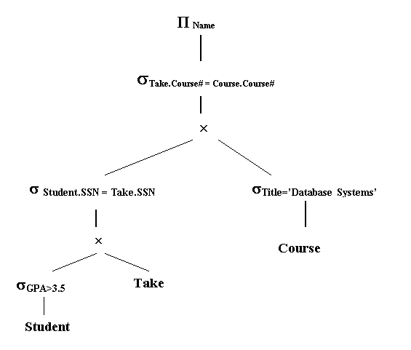

Slide 42
∏ _{Name}


σ _{Title = ‘Database System’}
σ _{GPA > 3.5}
Take
Course
Student

Slide 43
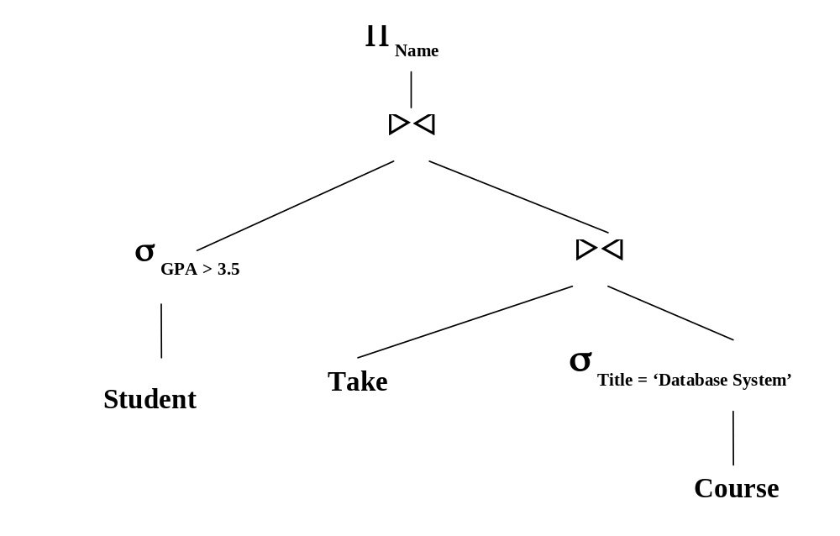

Slide 44
∏ _{Name}

∏_{SSN, Name}

∏ _{Course#, SSN}
∏ _{Course#}
σ _{GPA > 3.5}
Take
σ _{Title = ‘Database System’}
Student
Course

Slide 45
Execution Plan
The actual execution plan generated from Figure 5.7.e could have the following steps:
1. ∏_{Course#} (σ_{Title=’Database Systems’}(Course)). Let T1 be the result.
2. ∏_{SSN, Course#} (Take). Let T2 be the result.
3. T1  T2. Let T3 be the result.
4. ∏_{SSN, Name} (σ_{GPA>3.5} (Student)). Let T4 be the result.
5. ∏_{Name} (T3  T4).
Note: The two first steps can be carried out in any order. Step 3 and step 4 can be carried in reserse order.

Slide 46
A bad case of algebra-based optimization
Algebra-based heuristic optimization may result in bad execution plans.
Example: Given two relations Student and Faculty. Suppose a clustered index exists on SSN of both relations. The query “Identify those faculty members who are also students with GPA > 2” has 2 possible execution plans:
Plan A. σ_{GPA>2}(Student  _{Student.SSN= Faculty.SSN} Faculty)
Plan B. (σ_{GPA>2}(Student))  _{Student.SSN= Faculty.SSN} Faculty
Plan B will be chosen by Optimization rule 1.
However, Plan A is much better than Plan B if there is no index on GPA of Student.

Slide 47
COST ESTIMATION FOR RELATIONAL ALGEBRA OPERATIONS
The basic idea of cost-estimation based optimization approach can be described as follows:
For each query, enumerate all possible execution plans. For each execution plan, estimate the cost of the execution plan. Finally, choose the execution plan with the lowest estimated cost.
How to estimate the cost of an execution plan?

Slide 48
Single Operation Processing
An execution plan consists of a sequence of operations and a strategy for evaluating each operation.
This section discuss techniques for evaluating several relational operations – selection, projection, and join.
Cost analysis for each strategy is also provided.
Let R and S are two relations under consideration. Let n and m be the numbers of tuples in R and S. Let N and M be the sizes of R and S in pages.

Slide 49
Two types of cost
There are two types of costs in our analysis: I/O cost and CPU cost. The total cost of evaluating an operation or an execution plan is a weighted sum of I/O cost and CPU cost. I/O cost is the dominant cost.
• CPU cost: the number of comparisons needed and/or the number of tuples searched is used.
• I/O cost. Two methods for estimating I/O cost.
- The first method uses the total number of pages that are read or written.
- The second method uses the number of I/O operations initiated. One I/O operation may read/write many pages.

Slide 50
Selection operation
σ _{A op a} (R)
where A is a single attribute, a is a constant and op is one of comparison operators. Assume that op is not ≠.
Def: The selectivity of “A op a” on R, denoted as S_{A op a} (R), is the percentage of the tuples of R that satisfy “A op a”.
Let k be the number of tuples of R that satisfy “A op a”. Then k is estimated to be n.S_{A op a} (R).
The cost of evaluating can be analyzed as follows:

Slide 51
Selection operation (case 1)
Case 1. Fast access path is not available or not used.
Subcase 1.1. Tuples are stored in sorted. Binary search can be used.
I/O cost: O(log₂ N + ⎡(k/n).N⎤ )
N: the number of pages needed to hold the tuples of R
⎡(k/n)N⎤ is the number of pages needed to hold the tuples satisfying the selection condition.
CPU cost: O(log₂n + k)
Subcase 1.2. Tuples are not stored in sorted A-values. A sequential scan is needed.
I/O cost: O(N)
CPU cost: O(n)

Slide 52
Selection operation (case 2)
Case 2: Fast access path is used.
Subcase 2.1. Tuples are stored in sorted A-values. (The fast access is a primary index). It takes a constant number of steps to find the first qualified tuple using the fast access path.
I/O cost: O( ⎡(k/n).N⎤ )
CPU cost: O(k)
Subcase 2.2. Tuples are not stored in sorted A-values. (The fast access is a secondary index).
Since each qualified tuple can be obtained by fetching a constant of pages, I/O cost is bounded by O(k). And we never need to read in more than N pages.
I/O cost: O(min{k, N}).
CPU cost: O(k).

Slide 53
Projection operation
∏_{A1,…,At}(R)
Two cases may occur.
Case 1. Duplicate rows are not removed. The projection can be done by scanning each tuple once.
I/O cost: O(N)
CPU cost: O(n)

Slide 54
Projection operation (case 2)
Case 2. Duplicate rows are removed. This is accomplished in 3 steps:
- The relation is scanned and a projection that keeps duplicate
rows is performed.
- The result of first step is sorted. After the sort, duplicate rows must appear in adjacent locations.
- The sorted result is scanned for duplication removal.
The I/O cost is dominated by the first step. The I/O cost for the first step is O(N).
The CPU cost is dominated by sorting and the sorting cost is O(nlog n). The sorting step requires an external sort as the main memory can not accommodate all the data to be sorted.

Slide 55
Join operation
Among the three most frequently used operations (i.e., selection, projection and join), join is the most expensive operation.
There are several well-known algorithms for evaluating the join operation. Only equijoin will be considered.
R _{R.A = S.B} S.
Without loss of generality, we assume that S is the smaller of the two relations. (i.e., M ≤ N).

Slide 56
Nested Loop
This algorithm compares every tuple of R with every tuple of S directly for finding the matching tuples.
for each tuple x in R
for each tuple y in S
if x[A] = y[B] then return (x y)
R is used in the outer loop and is called the outer relation. S is used in the inner loop and is called the inner relation.
CPU cost: O(m.n)

Slide 57
A special case of nested loop
To estimate I/O cost, we modify the above algorithm to be page-based. Let K be the size (in pages) of memory buffer for the join. K is used to denote only the buffer pages available for the two join relations.
Special case: K = 2. When R is outer relation and S is the inner.
for each page P of R
for each page Q of S
for each tuple x in R
for each tuple y in S
if x[A] = y[B] then return (x y)
This algorithm scans the inner relation once for each page of the outer relation.

Slide 58
Rocking scan
An improvement: If the inner relation is scanned from the first page to the last page for the current iteration, then it will be scanned from the last page to the next page for the next iteration.
In this way, the last page of S is not reread into the main memory and we save one I/O page reading. (Rocking scan).
I/O cost: N + M + (N-1)*(M-1) = N*M +1

Slide 59
Nested loop (general case)
K ≥ 2. Suppose R uses K1 buffer pages and S uses K2 buffer pages where K1+K2 = K, K1 ≤ N, K2 ≤ M.
for each K1 pages P of R
for each K2 pages Q of S
for each tuple x in R
for each tuple y in S
if x[A] = y[B] then return (x y)

Slide 60
Nested loop –General case (cont.)
When using rocking scan technique, R will be read only once, for the first K1 pages of R, the entire S needs to be read, and for each subsequent K1 pages of R (there are ⎡N/K1⎤ -1 such K1 pages of R), only M-K2 pages of S need to be read.
I/O cost is:
N+M + ( ⎡N/K1⎤ -1).(M – K2) (*)
It can be shown that Expression (*) reaches the minimum when K1 = min{N, K-1}.

Slide 61
Sort Merge
This join algorithm consists of the following two steps:
1. Sort the two relations in ascending order of their respective joining attributes, i.e., sort R on A and sort S on B if they are not already sorted.
2. Perform a merge join. We first consider the case when the values under at least one joining attribute are distinct.

Slide 62
C A
5
6
9
10
17
20
B D
4
6
6
10
17
18
Assume that A is a key of R. Initially, two pointers are used to point to the two tuples of the two relations that have the smallest values of the two joining attributes.

Slide 63
Sort merge (cont.)
If the two values are the same, then first concatenate the two corresponding tuples to produce a result and then move the pointer pointing to a tuple of S one position lower, to the next tuple of S. If the two values are different, then the pointer pointing to the tuple with smaller value is moved down one position, to the next tuple.
This process is repeated until all values under the two attributes are exhausted.
Note: In the case when both attributes have repeating values, modification must be made to the above procedure to ensure that all equal values under the two attributes are exhautively matched.

Slide 64
The cost of merge-sort for join operation
The cost of this algorithm depends on
(1) whether one or both relations have been sorted on the joining attribute and on
(2) how many repeating values appear under both joining attributes.
• In the best case, both relations are sorted and there are no repeating values. In this case, only step 2 is needed and one scan of each relation is sufficient to perform the merge join.
CPU cost: O(m+n)
I/O cost: O(M + N)

Slide 65
The cost of merge-sort (cont.)
•In the worse case, both relations are not sorted and nearly all values under the two joining attributes are repeated. In this case, both relations need to be sorted and almost a full Cartesian product between the two relations is needed.
CPU cost: O(nlog n + mlog m + n.m)
I/O cost: O(Nlog N + M log M + C(R,S))
where C(R,S) is the I/O cost of performing the Cartesian
product between R and S.

Slide 66
Hash Join
The basic hash join algorithm consists of two steps:
1. Build a hash table for the smaller relation S based on the joining attribute. The tuples are placed in the buckets.
2. Use the larger relation R to probe the hash table to perform the join. The probe process is described below.
for each tuple x in R
{ hash on the joining attribute using the same hash function used in step 1 to find a bucket in the hash table;
if the bucket is nonempty
for every tuple y in the found bucket
if x[A] = y[B] then return (x, y) }

Slide 67
Note
1. Using the same hash function in both steps is important for hash join since it guarantees that tuples with the same joining attribute values from the two relations will be mapped to the same buckets.
2.Tuples mapped to the same bucket may have different values on the joining attribute. Therefore comparing with every entry in the found bucket is needed.

Slide 68
Complexity of hash join
For each tuple t of the larger relation, every tuple in the bucket to which t is mapped needs to be examined for entries matching with it.
⇒ CPU cost: O(m + n.b) where b is the average
number of tuples per buckets.
If the hash table can be kept in memory, then each relation need to be read in only once.
⇒ I/O cost: O(M+N).

Slide 69
Comparison of the Join Algorithms
1 1. Hash join is a very efficient join algorithm when it is applicable. However, hash join is only applicable to equi-join.
2. Sort merge join performs better than nested loop when both operand relations are large.
When both input relations are already sorted on the joining attributes, sort merge join is as as good as hash join.
3. Nested loop join perform well when one relation is large and one relation is small.
When nested loop join is combined with the index on the joining attribute of the inner relation, it works excellently.

Slide 70
Cost-estimation-based optimization
If the cost of every execution plan can be estimated accurately, then the optimal plan can be eventually found.
Two difficulties with cost-estimation based optimization:
There may be too many possible execution plans to enumerate.
It may be difficult to estimate the cost of each execution plan accurately.
In a complex execution plan, the result of an operation, say Op1, may be used as input to another operation, Op2. To estimate the cost of Op2, we need to estimate the size of the result of Op1. The most difficult part in estimating the cost of an execution plan is to estimate the sizes of intermediate results.

